Slide 1
More Loops and Code Editors
BDPA Indy SITES
03/06/2020

Slide 2


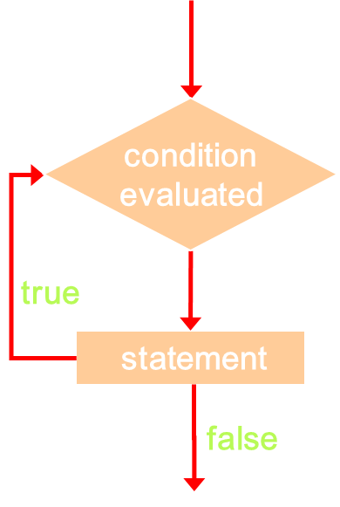
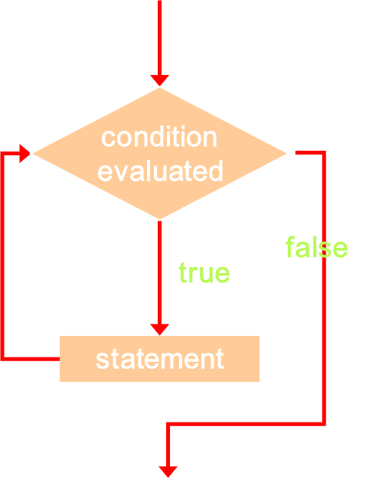
Quick Quiz: Name That Loop!

Slide 3
The while Loop syntax
0
A while statement has the following syntax:
while ( condition ){
statements;
}
condition
evaluated
false
true
If the condition is true, the statement is executed
Then the condition is evaluated again, and if it is still true, the statement is executed again
The statement is executed repeatedly until the condition becomes false
statement

Slide 4
The Do while Loop syntax
0
A while statement has the following syntax:
do{
statements;
}
while ( condition )
condition
evaluated
true
The statement is executed once initially, and then the condition is evaluated.
The statement is executed repeatedly until the condition becomes false
statement
false

Slide 5
The for Statement
A for statement has the following syntax:
initialization
The initialization
is executed once
before the loop begins
The statement is
executed until the
condition becomes false
condition
evaluated
true
false
for ( initialization ; condition ; update ){
statements;
}
statements
The increment portion is executed at the end of each iteration
update

Slide 6
For loop example
for (int count=1; count <= 3; count++){
Console.log(count);
}
for (int count=1; count <= 10; count++){
count += 3
Console.log(count);
}

Slide 7
The for Statement
Each expression in the header of a for loop is optional
If the initialization is left out, no initialization is performed
If the condition is left out, it is always considered to be true, and therefore creates an infinite loop
If the increment is left out, no increment operation is performed

Slide 8
Nested Loops
Similar to nested if statements, loops can be nested as well
That is, the body of a loop can contain another loop
For each iteration of the outer loop, the inner loop iterates completely
count1 = 1;
while (count1 <= 10){
count2 = 1;
while (count2 <= 20){
System.out.println ("Here");
count2++;
}
count1++;
}

Slide 9
Nested loops
count1 = 1;
while (count1 <= 10){
count2 = 1;
while (count2 <= 20){
Console.log("Here");
count2++;
}
count1++;
}
for (int count1=1; count <= 10; count1++){
for (int count2=1; count2 <= 20; count2++){
Console.log("Here");
}
}

Slide 10
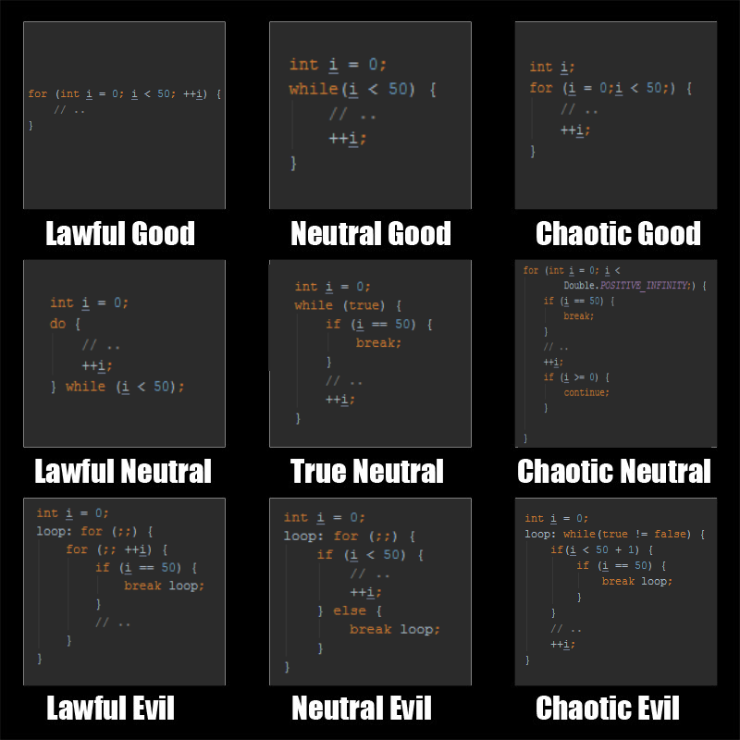
Best Practices for Using loops (Please don’t do most of these. I beg you.)

Slide 11
GitHub Back end Repo & Classroom
Check email for GitHub verification for the BDPA-SITES-Indy repos
Bookmark https://github.com/orgs/BDPA-SITES-Indy/teams/back-end
Post a quick test message in “Discussions”
Go to https://github.com/BDPA-SITES-Indy/Back-End
Explore each tab and familiarize your self with the repo
Go to https://classroom.github.com/classrooms/58524157-back-end-class
Check out your second homework in GitHub

Slide 12
Atom By Github
Open source text editor
Links directly to GitHub for easy access to your repositories
Supports HTML, CSS, JavaScript and more!

